Slide 1
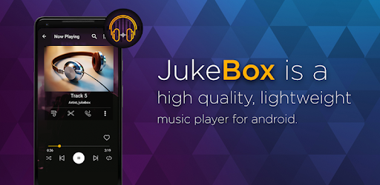
MY JUKEBOX MUSIC PLAYER
PRESENTED BY: HARSH SINGH (wave26)
MENTORS: SANGEETHA MAM, HASIB SIR, SAURABH SIR

Slide 2
TABLE OF CONTENTS
Introduction
Problem Statement
Requirements
Objective and Functionality
Applications Requirements
Class Diagram
E.R Diagram
Advantages
Conclusion

Slide 3
Why we need this project
Jukebox is a social media player that lets you share music across limitless people, devices and speakers, whether they're in the same room or halfway across the world. Create & share your Jukebox now: Join a public Jukebox to discover and listen to music with others across the globe!
Jukeboxes were invented even before digital music came into existence – and certainly much before streaming music became available.
Music jukeboxes were commonly used in restaurants and bars to enable customers to choose what music they wanted to listen to. Electronic and digital jukeboxes became prevalent from the 70’s and 80’s. Modern jukeboxes are fully computerized and play stream music from the internet directly

Slide 4
Problem
Let us design a modern jukebox that allows users to listen to music and podcasts that are live streamed. There are a lot of tracks and episodes on the jukebox. So, whether you’re behind the wheel, working out, partying or relaxing, the right music or podcast is always at your fingertips. You can also browse through the artists, and celebrities, or create a playlist and just sit back. ● In this challenge you will design a modern jukebox that contains songs by various artists and podcasts by celebrities. ● Project scope is divided into 4 tasks to be done over 24 hours

Slide 5
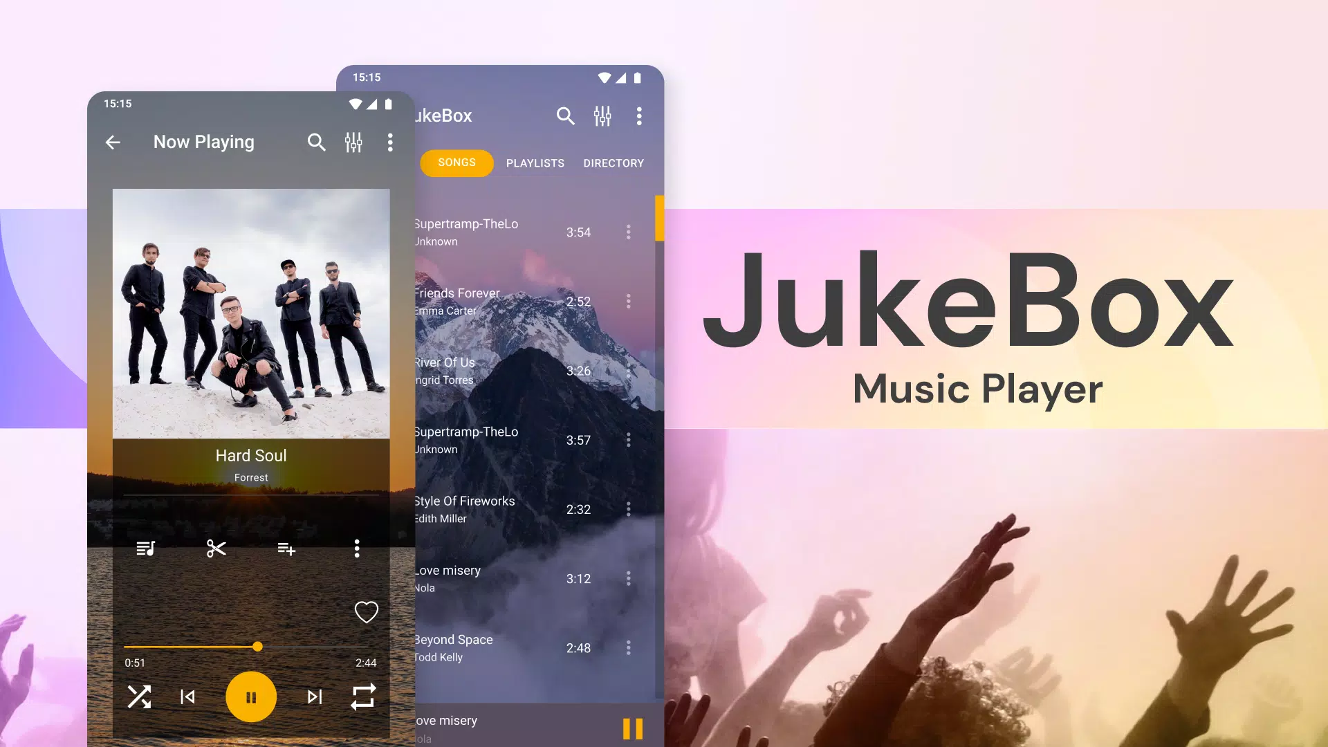


Slide 6
Requirement
TASK :1
The jukebox contains a catalog of songs by various artists. Add different genres of songs into the catalog. ● The catalog can be categorized based on the artist, genre or name of the album. ● The home page of the jukebox displays all the songs available in the catalog. ● Ability to search for music based on any of the categories mentioned in point 2. Once a category is specified, an alphabetical search can be offered to the user to locate the music they are looking for.
TASK :2
The modern jukebox allows users to create a catalog of podcasts and to live stream music of various artistes. ● The homepage of the jukebox displays podcasts by celebrities. ● Allows a user to search for a podcast by celebrity or date on which the podcast was published.

Slide 7
Requirement
TASK :3
The jukebox allows a user to either create a playlist of songs or podcasts or a combination of the two. ● Allows the user to add a song or a particular album or a podcast to the created playlist. ● The user can create multiple playlists and can view the contents of the playlists. TASK :4
The design of the modern jukebox has been completed, now a user can play songs from the created playlists. ● Display all the songs in the playlist along with the name of the song, album name if any and the duration of the song in a tabular format. ● The user must be able to play any song or podcast from the playlist. ● The current song that is playing with the time remaining in mm:ss format and the list of songs that have been queued up for playing subsequently. ● The user must be able to perform reverse, forward, pause, resume and shuffle or loop play of the songs in the playlist.

Slide 8
Objectives And Functionality
Create New User
Login Existing User
-> User can play songs, podcasts
-> can see existing songs and podcast list
-> User can create playlist and search, short the songs according to it
-> User can insert songs and podcasts in the playlist
-> can delete song or podcast
-> User can upload songs and podcast on server Database
-> they can play, pause, shuffle and stop songs or podcast like real player

Slide 9
Knowledge of topics required
Loops
OOP’s
Shorting and searching
JDBC
MySQL database
Exception Handling
Method creation and calling
Interface and DAO classes

Slide 10
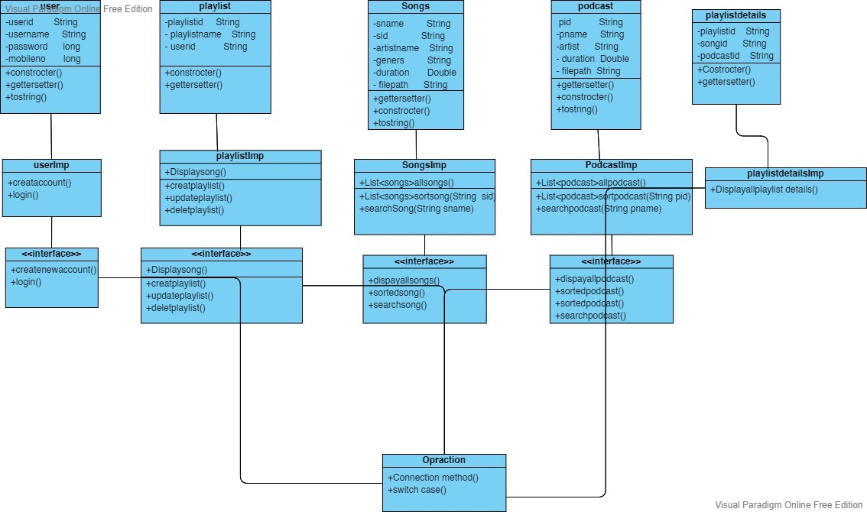
CLASS DIAGRAM

Slide 11
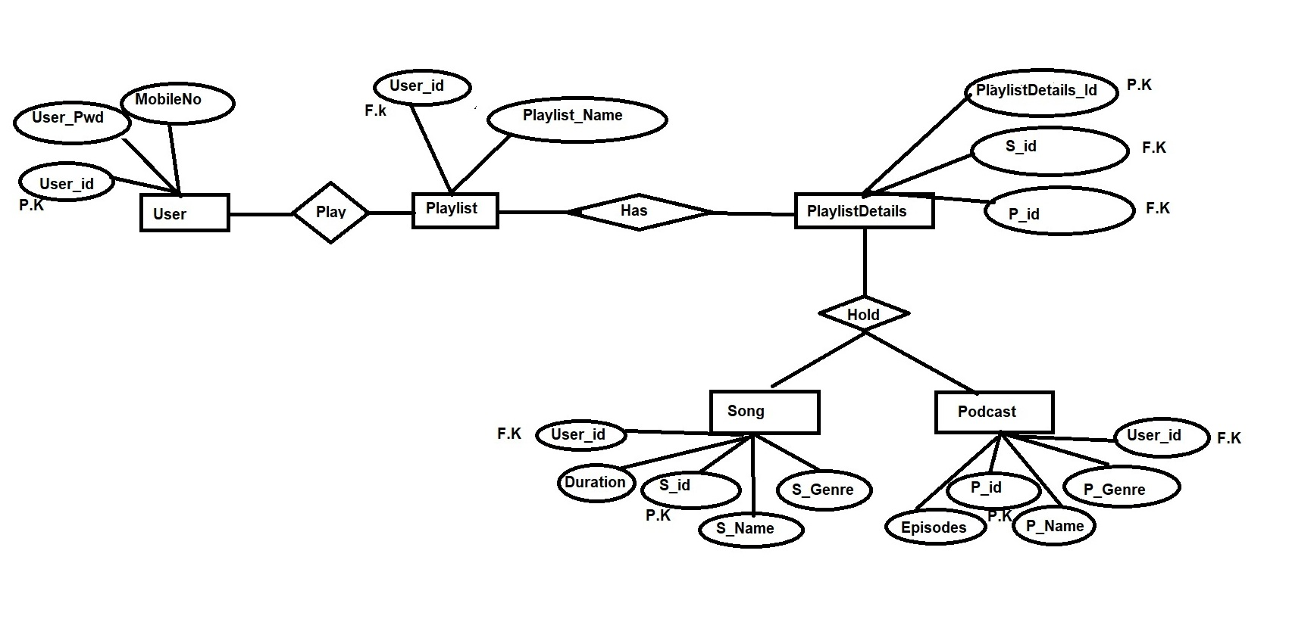
ENTITY RELATIONSHIP DIAGRAM

Slide 12
Applications Required
MySQL
Server Database
Java 1.8 or Above
J.D.B.C
Java Connector
Junit Test dependency's
Any of IDE

Slide 13
ADVANTAGEs
ADVANTAGES
-> Its quick and user fr

Slide 14


